Slide 1

From Data to Decisions: An Introductory Guide to End-to-End ML Projects
Gaurav Ojha

Slide 2
About Me
Education:
B.Tech in Bioinformatics and Data Science (Gold Medalist) - DY Patil, Navi Mumbai
M.Tech in Data Science - MPSTME, NMIMS, Mumbai

Slide 3
About Me
Work Experience:
Machine Learning Intern – T3MGEN, Bangalore (Jan 2022 – Jun 2022)
Lead Data Scientist – T3MGEN, Pune (Mar 2023 - Aug 2023)
Summer Intern (Investment Analyst) - Venture Center, Pune (May 2023 – July 2023)
Research Intern (Project Lead) - AkzoNobel India (June 2023 – Present)
Teaching Assistant – MPSTME, NMIMS Mumbai (July 2023 – Dec 2023)
Visiting Faculty – MPSTME, NMIMS Mumbai (Dec 2023 – Present)
Intern – Government and Public Services, KPMG (Dec 2023 – Present)

Slide 4
Outline
Prerequisites
Introduction
Building Base Classification Models
Evaluating Models
Data Cleaning
Data Pipeline
Exploratory Data Analysis
Building ML based algorithms using Streamlit
Cloud Deployment

Slide 5
Prerequisites
Install Anaconda
Set up Python environment
Install IDEs
Installing Required Libraries
Install Github Desktop

Slide 6

Introduction

Slide 7
What is Machine Learning?
It is a process by which:
Computers learn to make decisions from the data
Without being explicitly programmed

Slide 8


What is Machine Learning?

Slide 9
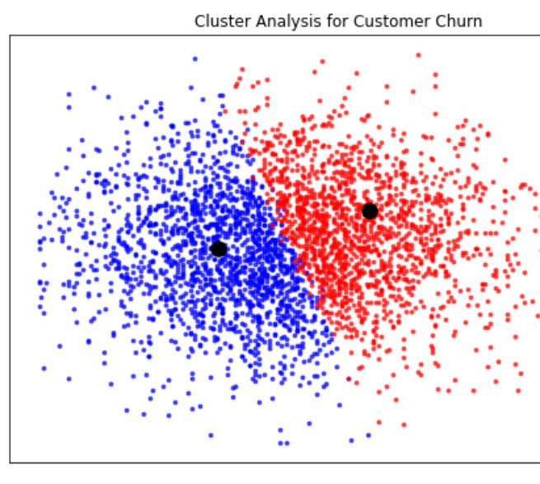
Unsupervised Learning
Unsupervised learning is the process of uncovering hidden patterns and structures from unlabeled data

Slide 10
Supervised Learning
Supervised learning is a type of machine learning where the values to be predicted are already known, and a model is built with the aim of accurately predicting values of previously unseen data.
Supervised learning uses features to predict the value of a target variable, such as predicting a basketball player's position based on their points per game.

Slide 11
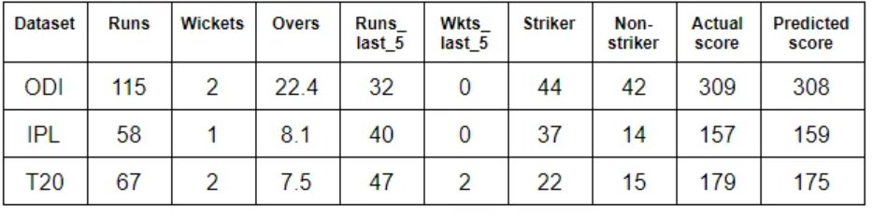
Supervised Learning

Slide 12
Types of Supervised Learning
Classification
Regression

Slide 13
Classification
Predict the label, or category of an observation
Eg. Predicting whether a bank transaction is fraudulent or not.
In the above example there are 2 outcomes: Fraudulent or Non-Fraudulent
It is called Binary Classification

Slide 14
Regression
Used to predict continuous values
Eg. Predicting price of a property based on features such as number of bedrooms, size of a property etc.

Slide 15
Naming Convention
Feature = Predictor Variable = Independent Variable
Target Variable = Response Variable = Dependent Variable

Slide 16
Requirements
No missing values
Data in numeric format
Data stored in pandas Dataframe or NumPy array
To ensure the above. We need to do Exploratory Data Analysis (EDA) first

Slide 17
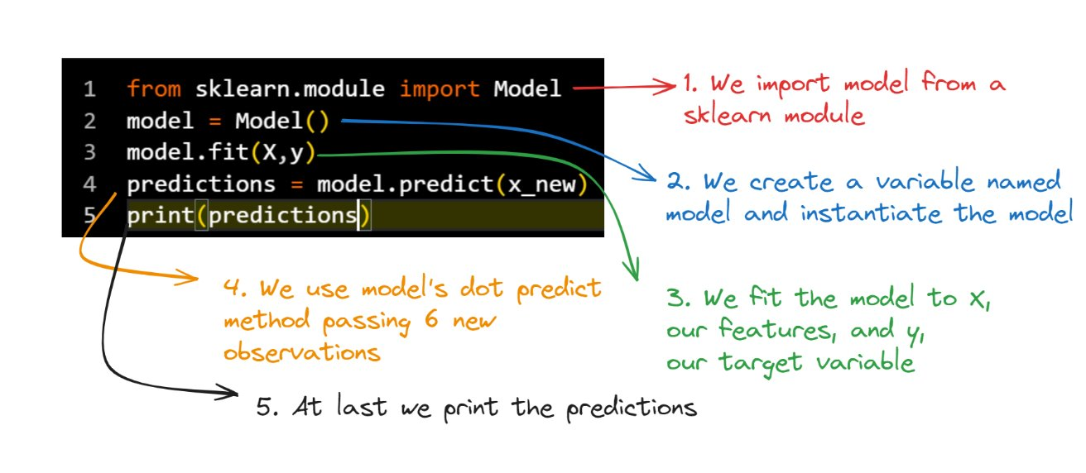
General Syntax

Slide 18
Exercise 1
Open jupyter lab
Load the csv "telecom_churn_clean" into a pandas dataframe
Look for missing values
Ensure that all the data is stored in numeric format

Slide 19
Mentimeter
15-20-87-4

Slide 20
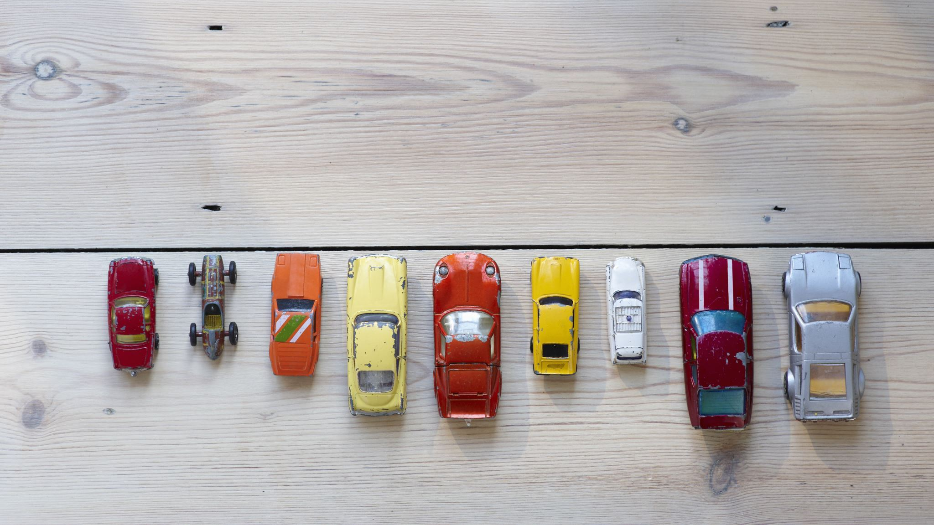
The Classification Challenge

Slide 21
Classifying Labels of Unseen Data
4 steps:
Build a model
Model learns from the labeled data we pass to it
Pass unlabeled data to the model as input
Model predicts the label of the unseen data

Slide 22
K-Nearest-Neighbors
Predict the label of a data point by:
Looking at k closest labeled data points
Taking a majority vote

Slide 23
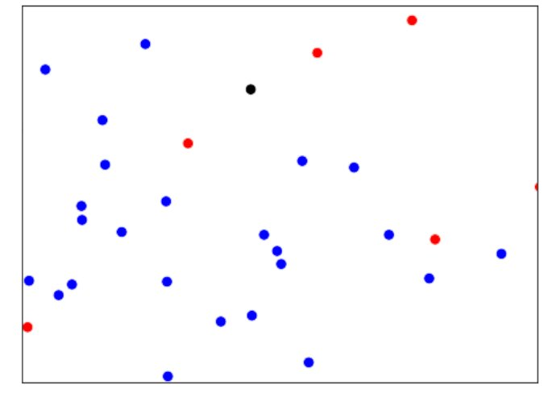
How do we classify the black observation?

Slide 24
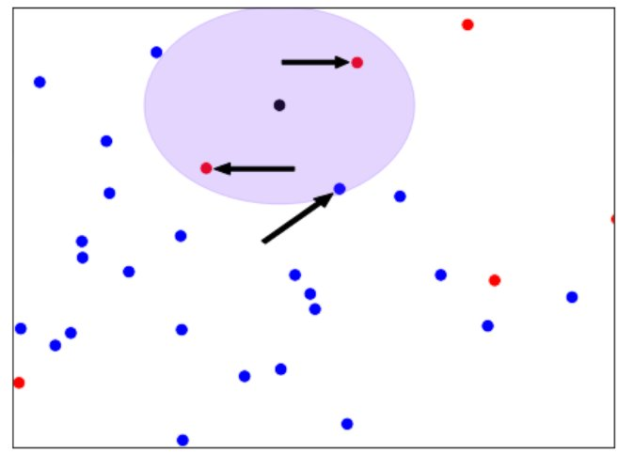
When K=3

Slide 25
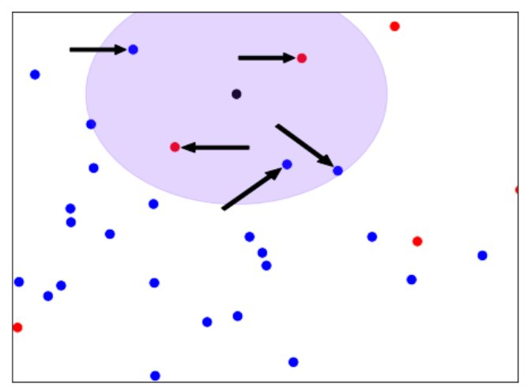
When k=5

Slide 26
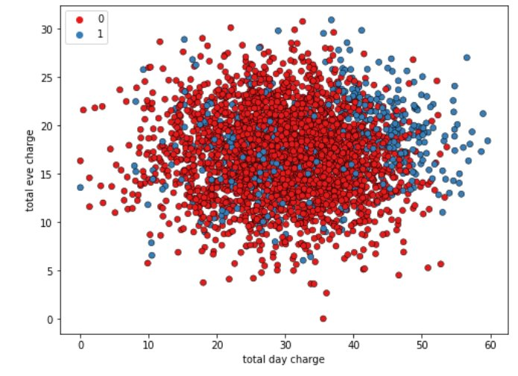
KNN Intuition
let's look at this scatter plot displaying total evening charge against total day charge for customers of a telecom company.
The observations are colored in blue for customers who have churned, and red for those who have not churned.

Slide 27
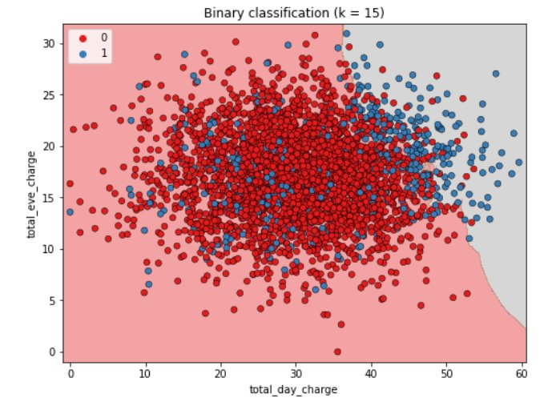
KNN Intuition
Here we have visualized the results of a KNN algorithm where the number of neighbors is set to 15.
KNN creates a decision boundary to predict if customers will churn.
Any customers in the area with a gray background are predicted to churn, and those in the area with a red background are predicted to not churn.
This boundary would be used to make predictions on unseen data.

Slide 28
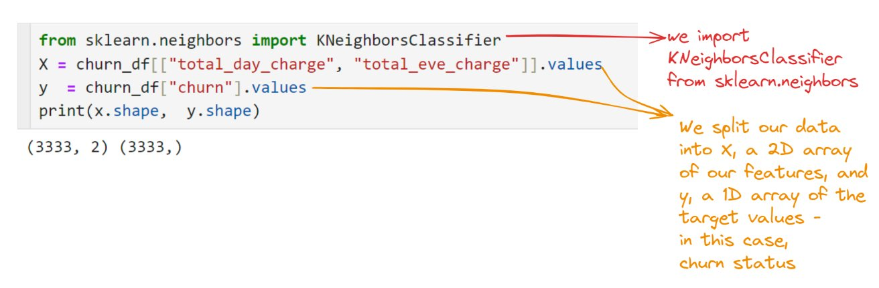
Using Scikit-learn to fit a classifier

Slide 29
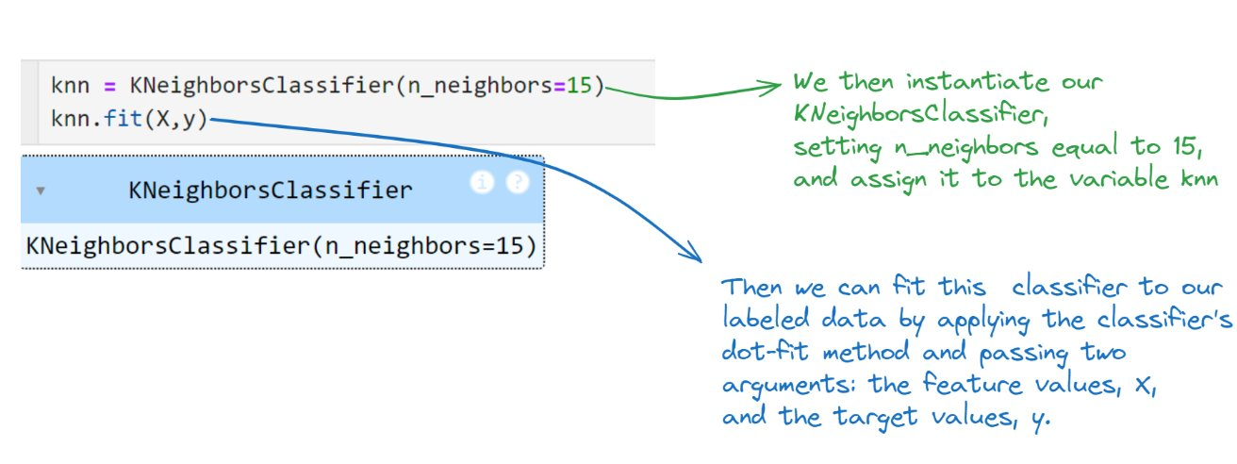
Using Scikit-learn to Fit a Classifier

Slide 30
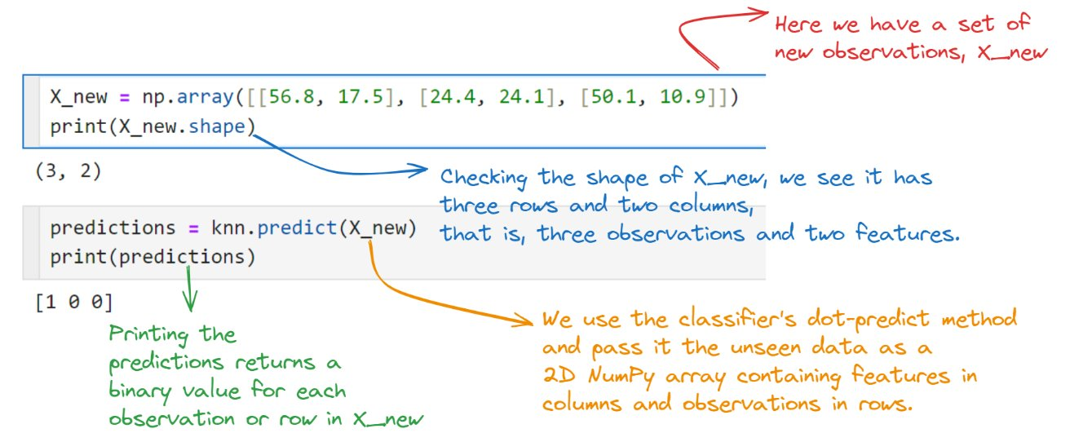
Predicting on Unlabeled Dataset

Slide 31
Exercise 2
Import `KNeighborsClassifier` from `sklearn.neighbors`
Instantiate a `KNeighborsClassifier` called `knn` with `6` neighbors
Fit the classifier to the data using `.fit()` method
You now have a KNN Classifier
These are the new observations for which predictions need to be made for: [30.0, 17.5], [107.0, 24.1], [213.0, 10.9]
use your classifier to predict the labels of a set of new data points

Slide 32
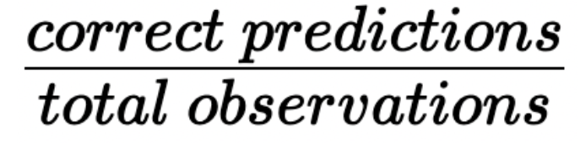
Measuring Model Performance
In classification, accuracy is the commonly used metric
Accuracy =

Slide 33
Measuring Model Performance
How do we measure accuracy?
We could compute accuracy on the data used to fit the classifier
NOT indicative of the ability to generalize

Slide 34
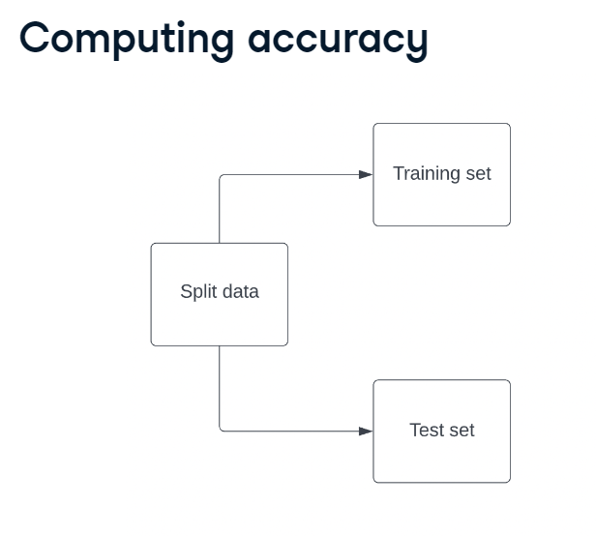
Computing Accuracy
It is common to split data into a training set and a test set.

Slide 35
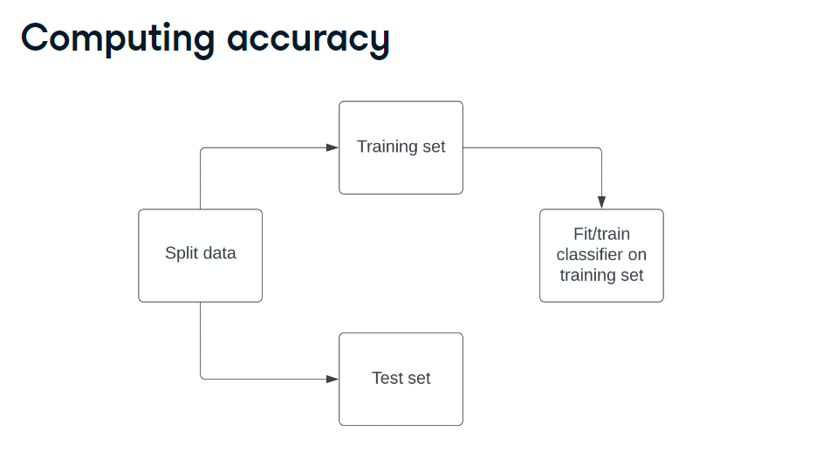
Computing Accuracy
We fit the classifier using the training set

Slide 36
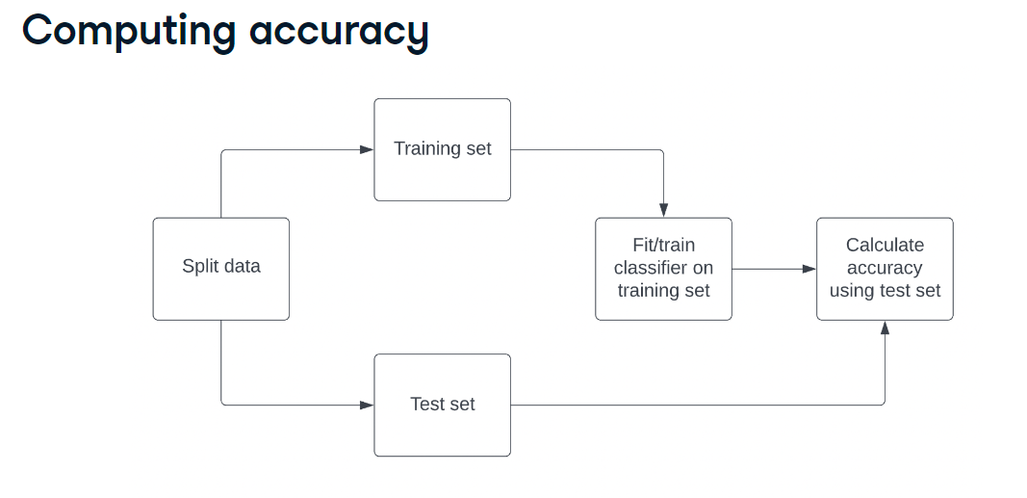
Computing Accuracy
then we calculate the model's accuracy against the test set's labels

Slide 37
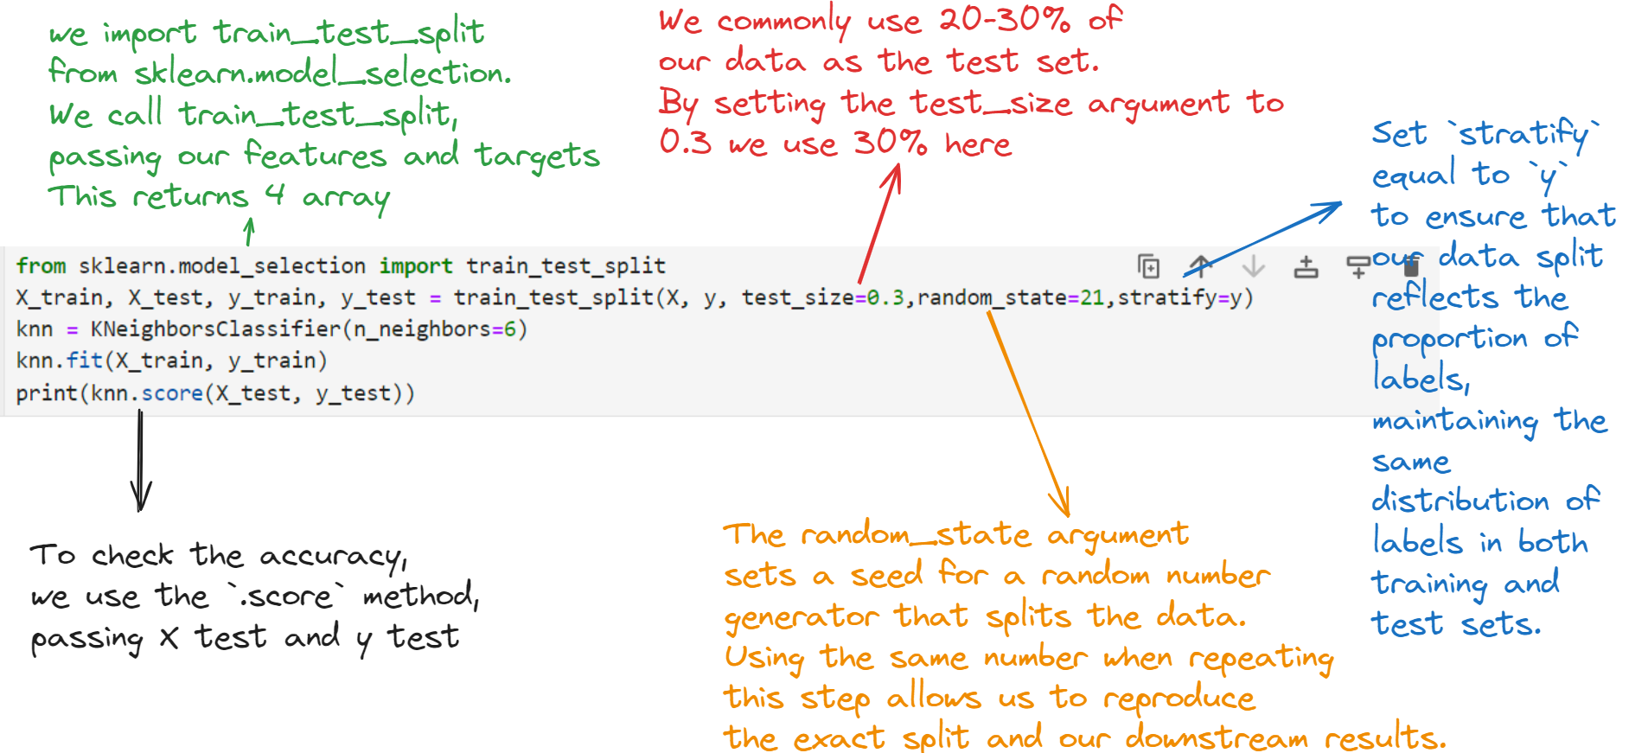
Train/Test Split
We commonly use 20-30% of our data as the test set. By setting the test_size argument to zero-point-three we use 30% here

Slide 38

The code just keeps getting complex!
This Photo by Unknown author is licensed under CC BY-SA-NC.

Slide 39
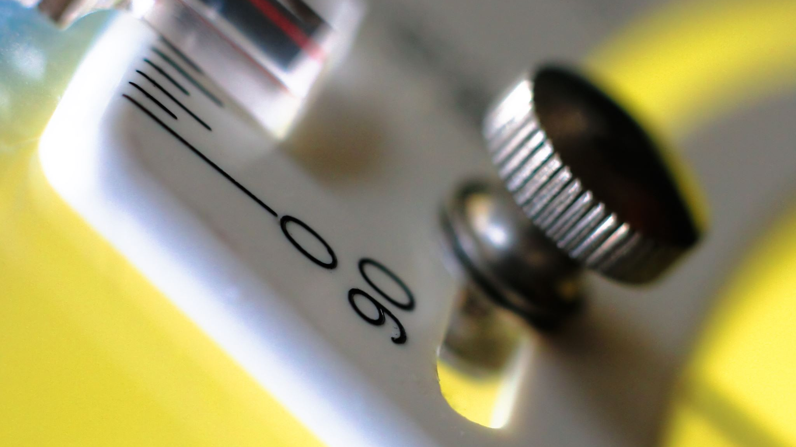
There's a solution - AutoML

Slide 40
Introducing Pycaret
PyCaret is an open-source, low-code machine learning library in Python that automates machine learning workflows. It is an end-to-end machine learning and model management tool that speeds up the experiment cycle exponentially and makes you more productive.
In comparison with the other open-source machine learning libraries, PyCaret is an alternate low-code library that can be used to replace hundreds of lines of code with few lines only.
This makes experiments exponentially fast and efficient.
PyCaret is essentially a Python wrapper around several machine learning libraries and frameworks such as scikit-learn, XGBoost, LightGBM, CatBoost, spaCy, Optuna, Hyperopt, Ray, and a few more

Slide 41
Build a KNN Model Using Pycaret

Slide 42
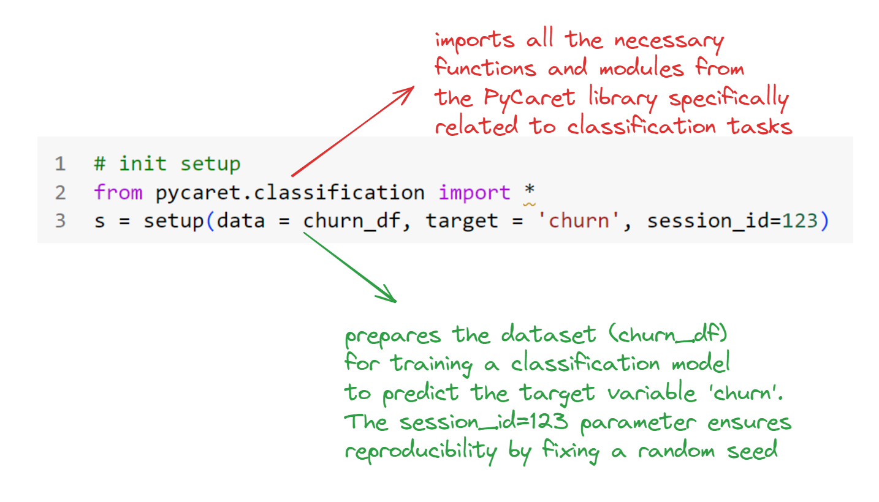
Setting Up The Pipeline

Slide 43
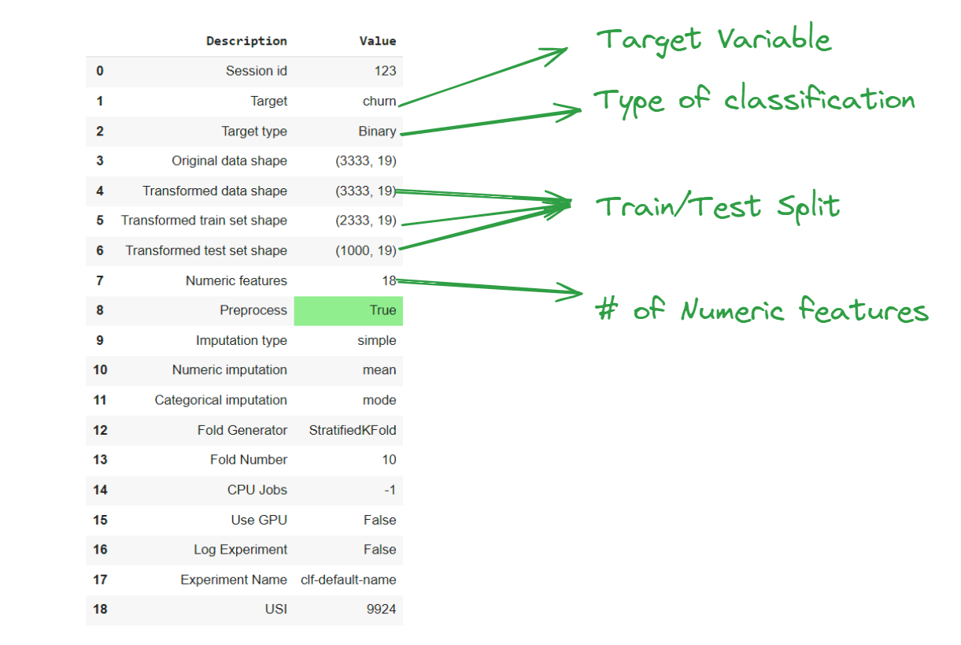
Setting Up The Pipeline

Slide 44
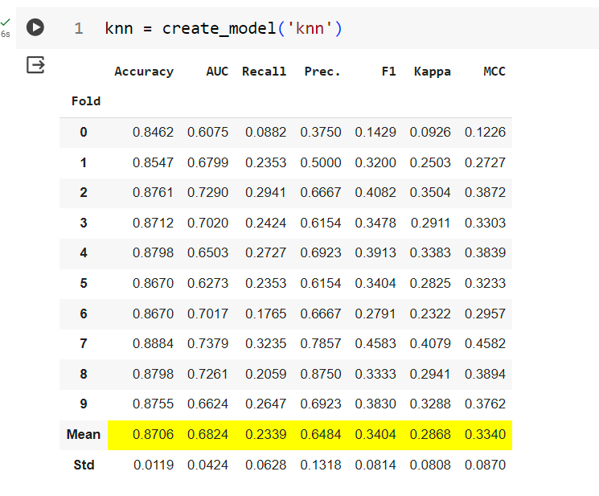
KNN Classifier
When a model is created using PyCaret, it also returns a classification report.

Slide 45
Classification Metrics
We can use accuracy, the fraction of correctly classified labels, to measure model performance.
However, accuracy is not always a useful metric.

Slide 46
Class Imbalance
In a model for detecting fraudulent bank transactions, only 1% of transactions are fraudulent.
A model that labels every transaction as legitimate achieves 99% accuracy but fails to predict fraud effectively.
This scenario, known as class imbalance, occurs when one class is significantly more prevalent than the other.
Typically, the legitimate transactions class vastly outnumbers fraudulent transactions.
Class imbalance is a frequent occurrence in real-world data and necessitates a distinct approach to evaluating model performance.

Slide 47
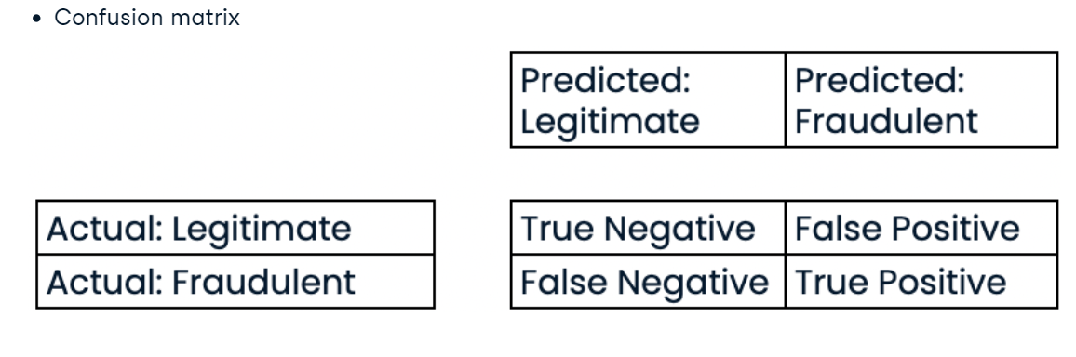
Confusion Matrix for Assessing Classification Problem
Given a binary classifier, such as our fraudulent transactions example, we can create a 2-by-2 matrix that summarizes performance called a confusion matrix.

Slide 48
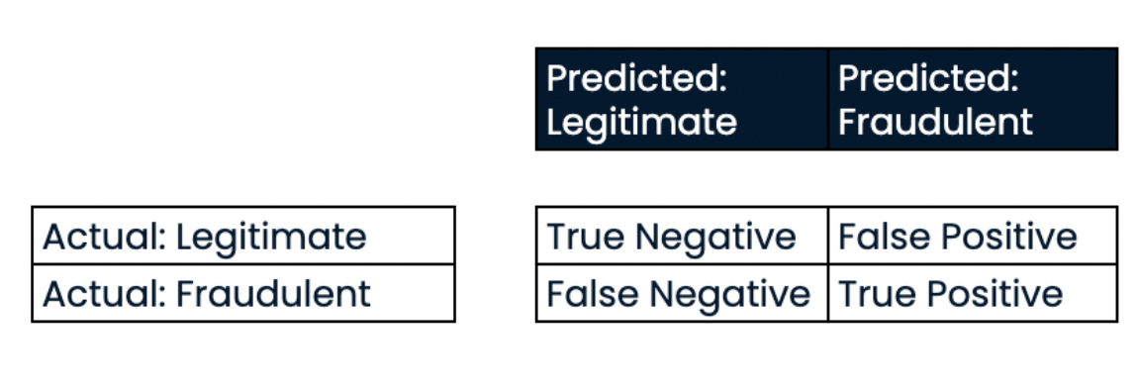
Assessing Classification Performance

Slide 49
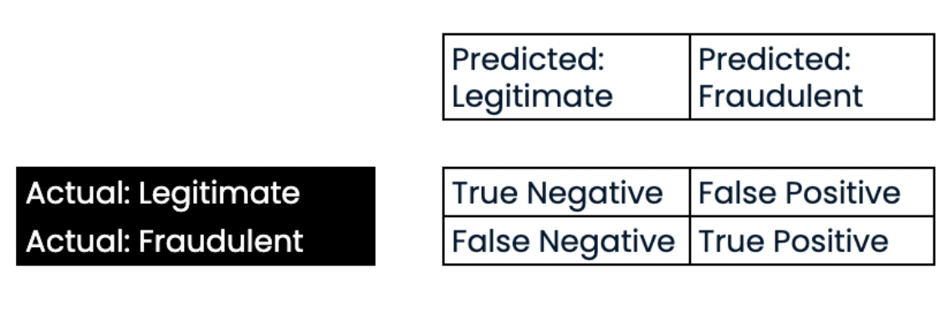
Assessing Classification Performance

Slide 50
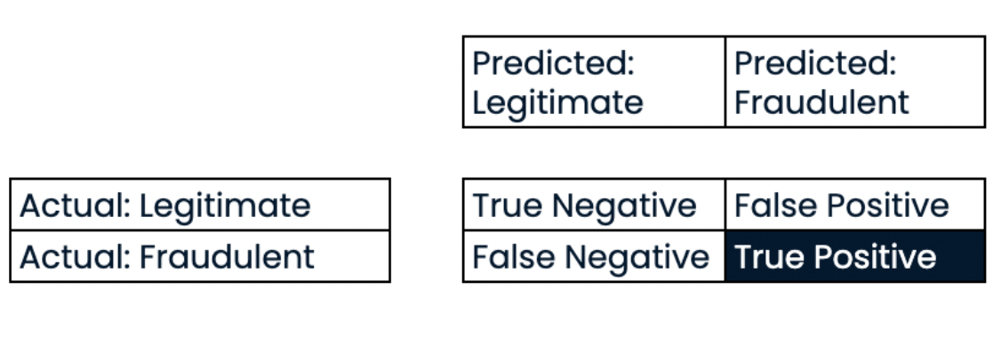
Assessing Classification Performance
The true positives are the number of fraudulent transactions correctly labeled

Slide 51
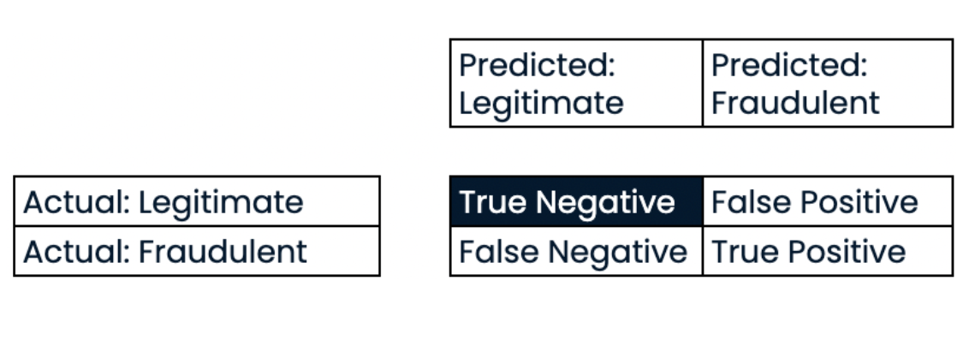
Assessing Classification Performance
The true negatives are the number of legitimate transactions correctly labeled;

Slide 52
Assessing Classification Performance
The false negatives are the number of legitimate transactions incorrectly labeled;

Slide 53
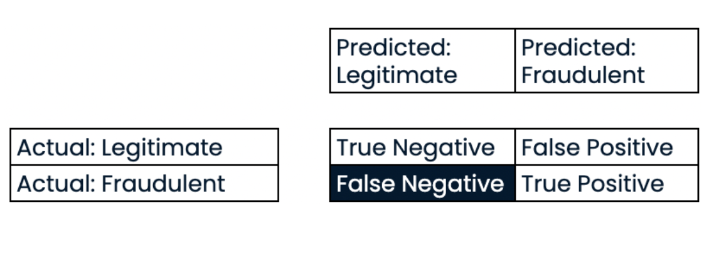
Assessing Classification Performance
And the false positives are the number of transactions incorrectly labeled as fraudulent.

Slide 54
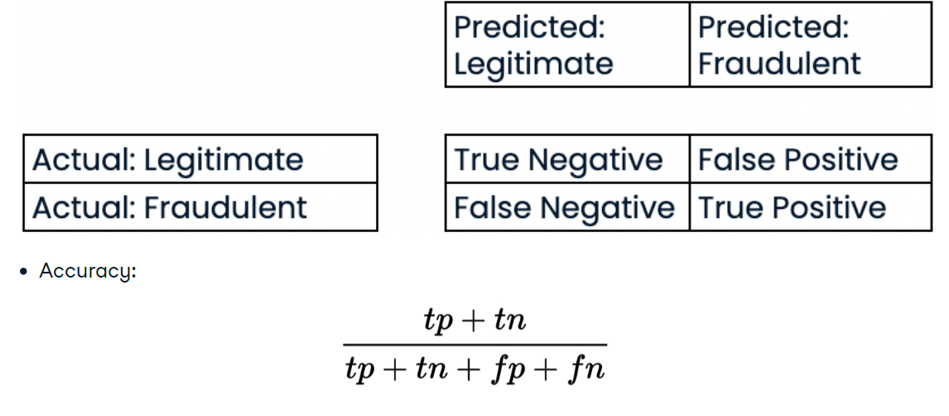
Assessing Classification Performance

Slide 55
Precision
Precision is the number of true positives divided by the sum of all positive predictions.
It is also called the positive predictive value.
In our case, this is the number of correctly labeled fraudulent transactions divided by the total number of transactions classified as fraudulent.
High precision means having a lower false positive rate. For our classifier, this translates to fewer legitimate transactions being classified as fraudulent.

Slide 56
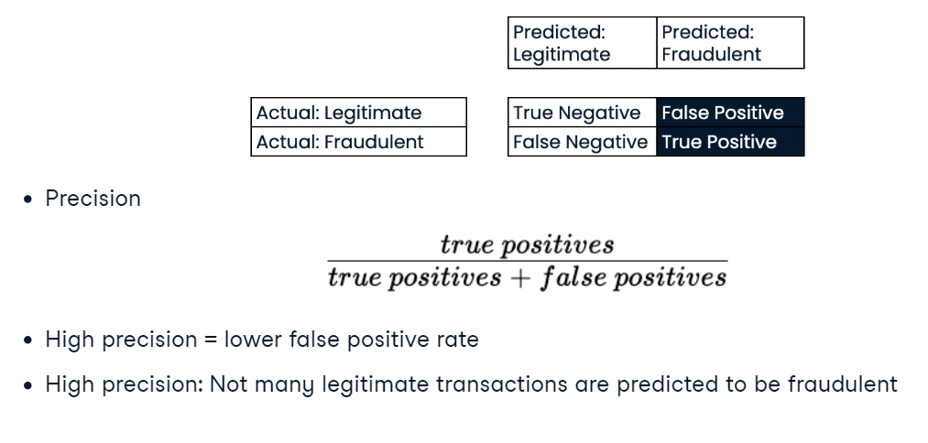
Precision

Slide 57
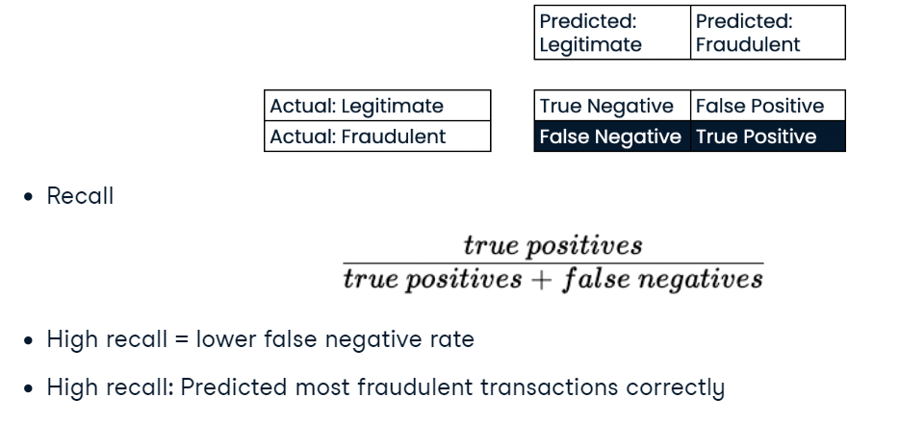
Recall
Recall is the number of true positives divided by the sum of true positives and false negatives.
This is also called sensitivity.
High recall reflects a lower false negative rate.
For our classifier, it means predicting most fraudulent transactions correctly.

Slide 58
F1 Score
The F1-score is the harmonic mean of precision and recall.
This metric gives equal weight to precision and recall, therefore it factors in both the number of errors made by the model and the type of errors.
The F1 score favors models with similar precision and recall, and is a useful metric if we are seeking a model which performs reasonably well across both metrics.

Slide 59
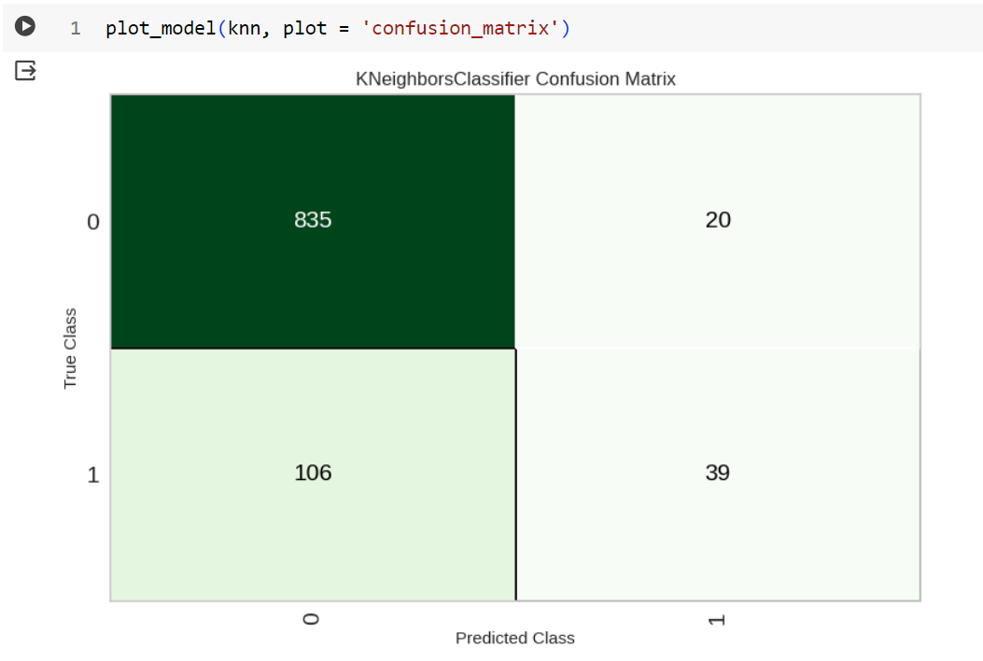
Confusion Matrix in PyCaret

Slide 60
Mentimeter
15-20-87-4

Slide 61
Exercise 3
Using Pycaret create a KNN classifier for the churn dataset
Get the classification Report
Plot the confusion matrix

Slide 62
Exercise 4
Using Pycaret create a KNN classifier for the diabetes dataset
Get the classification Report
Plot the confusion matrix

Slide 63

Time for Another Model

Slide 64
Logistic Regression for Binary Classification
Despite its name, logistic regression is used for classification.
This model calculates the probability, p, that an observation belongs to a binary class.
Using our diabetes dataset as an example, if p >= 0.5, we label the data as one, representing a prediction that an individual is more likely to have diabetes;
if p <= 0.5 , we label it zero to represent that they are more likely to not have diabetes.

Slide 65
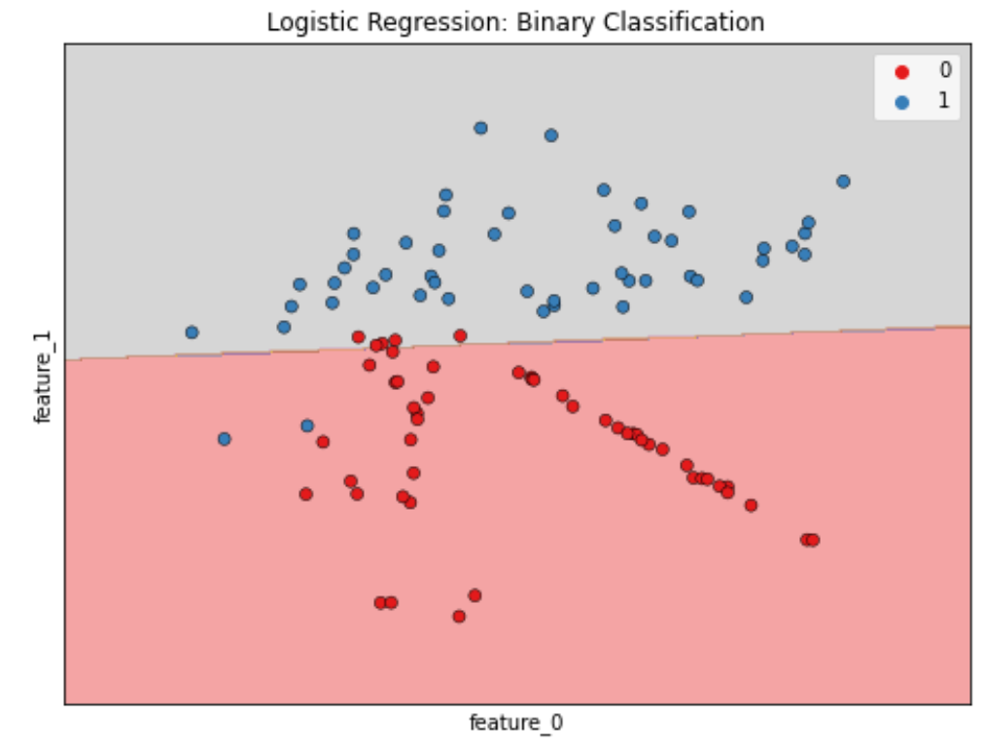
Linear Decision Boundary
Note that logistic regression produces a linear decision boundary, as we can see in this image.

Slide 66
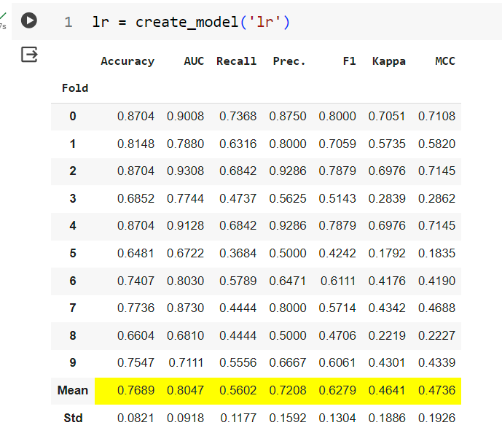
Logistic Regression in Pycaret

Slide 67
Probability Threshold
The default probability threshold for logistic regression in scikit-learn is 0.5.
This threshold can also apply to other models such as KNN.
So what happens as we vary this threshold?

Slide 68
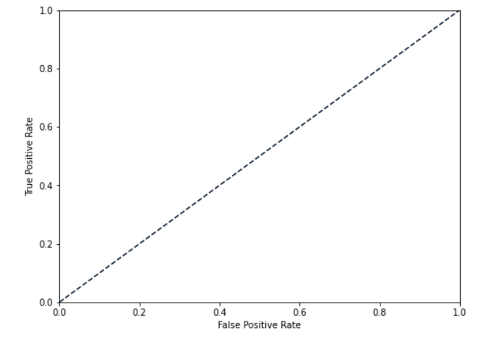
The ROC Curve
We can use a receiver operating characteristic, or ROC curve, to visualize how different thresholds affect true positive and false positive rates.
Here, the dotted line represents a chance model, which randomly guesses labels.

Slide 69
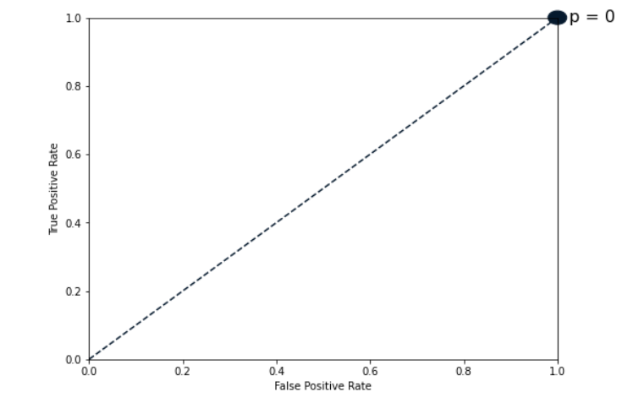
The ROC Curve
When the threshold equals zero, the model predicts one for all observations, meaning it will correctly predict all positive values, and incorrectly predict all negative values.

Slide 70
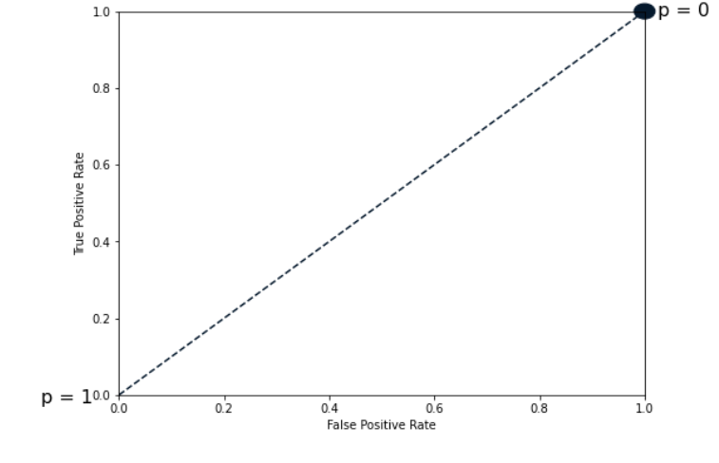
The ROC Curve
If the threshold equals one, the model predicts zero for all data, which means that both true and false positive rates are zero

Slide 71
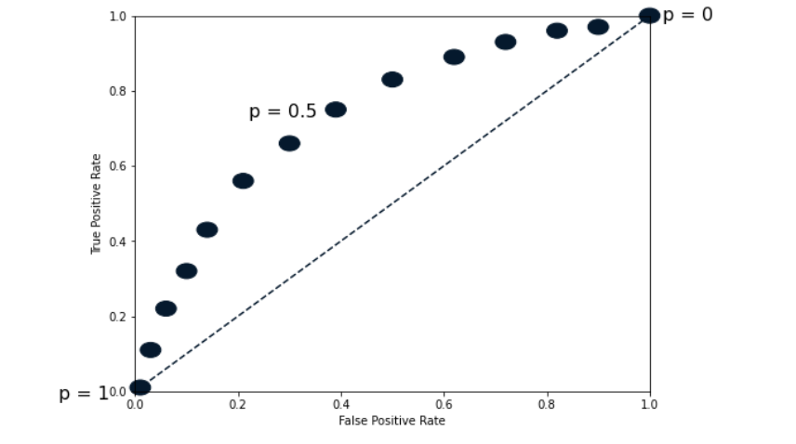
The ROC Curve
If we vary the threshold, we get a series of different false positive and true positive rates.

Slide 72
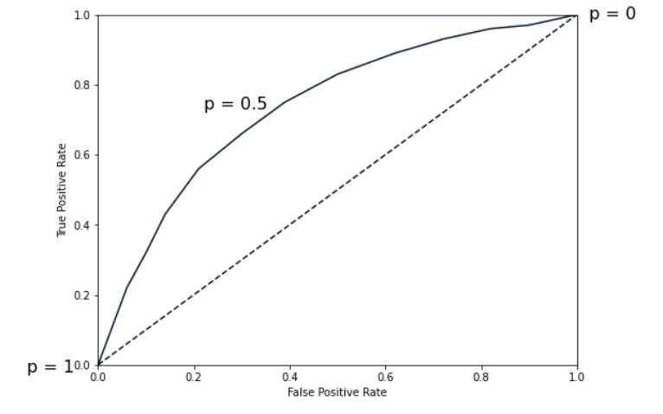
The ROC Curve
A line plot of the thresholds helps to visualize the trend.

Slide 73
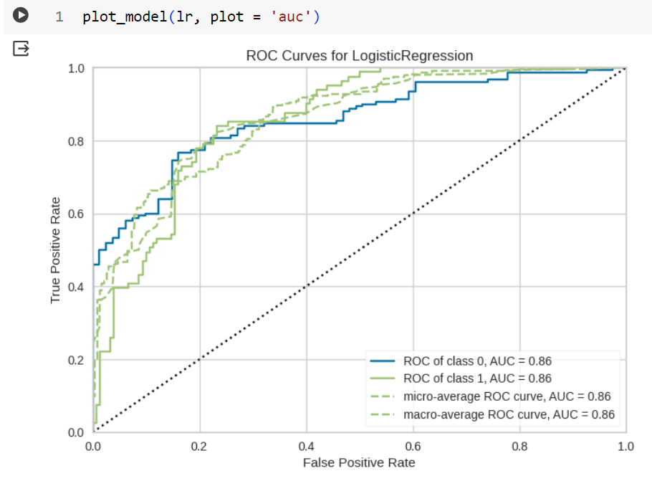
Plotting The ROC Curve

Slide 74
Quantifying Model Performance based on ROC Curve plot
If we have a model with one for true positive rate and zero for false positive rate, this would be the perfect model.
Therefore, we calculate the area under the ROC curve, a metric known as AUC.
Scores range from zero to one, with one being ideal. Here, the model scores 0.67, which is only 34% better than a model making random guesses.

Slide 75
Exercise 5
Create a logistic regression classifier to predict diabetes
Get the classification report for the lr model
Get the confusion matrix
Plot the ROC curve
Get the AUC for 'test' dataset

Slide 76
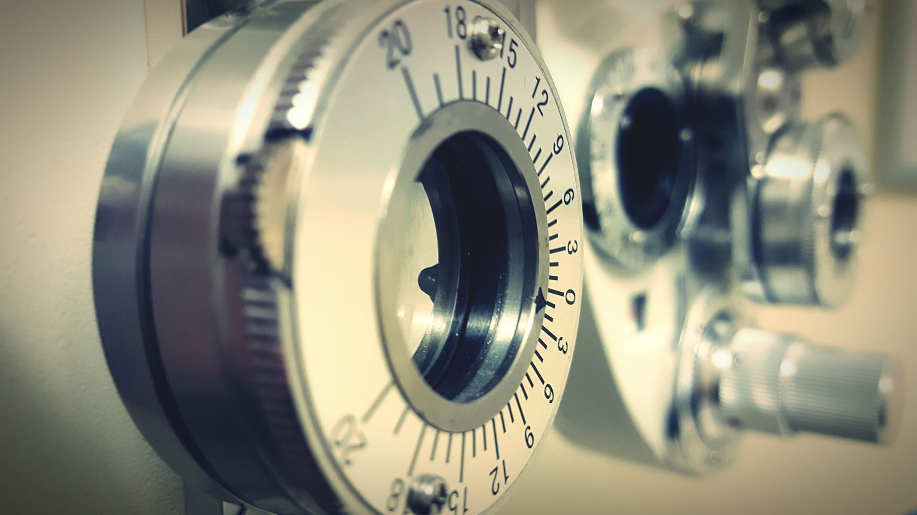
Hyperparameter Tuning

Slide 77
Hyperparameter Tuning
When a model is created using the create_model function it uses the default hyperparameters to train the model.
In order to tune hyperparameters, the tune_model function is used.
This function automatically tunes the hyperparameters of a model using random grid search on a pre-defined search space.
The output prints a scoring grid that shows Accuracy, AUC, Recall, Precision, F1, Kappa, and MCC by fold for the best model.
To use the custom search grid, you can pass custom_grid parameter in the tune_model function

Slide 78
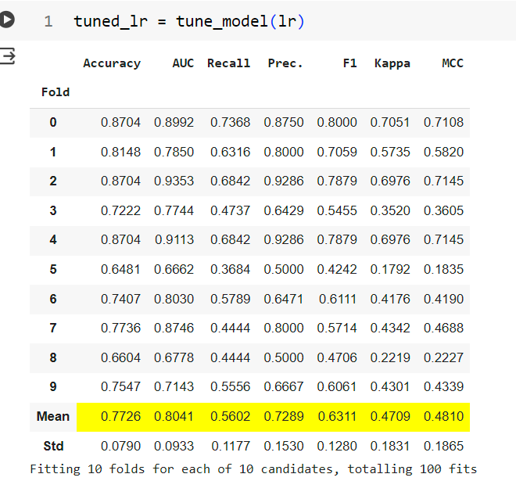
Tuning a model using PyCaret

Slide 79
Tuning a model using PyCaret
By default, tune_model optimizes Accuracy but this can be changed using optimize parameter.
For example: tune_model(lr, optimize = 'AUC') will search for the hyperparameters of a Logistic Regression that results in the highest AUC instead of Accuracy.

Slide 80
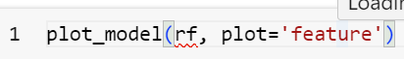
Feature Importance Plot
Feature importance cannot be plotted for all the algorithms
But the code for it is

Slide 81
Exercise 6
Tune KNN model for churn for accuracy
Also tune it for AUC
Tune LR model for accuracy
Check if feature importance plot can be made?

Slide 82
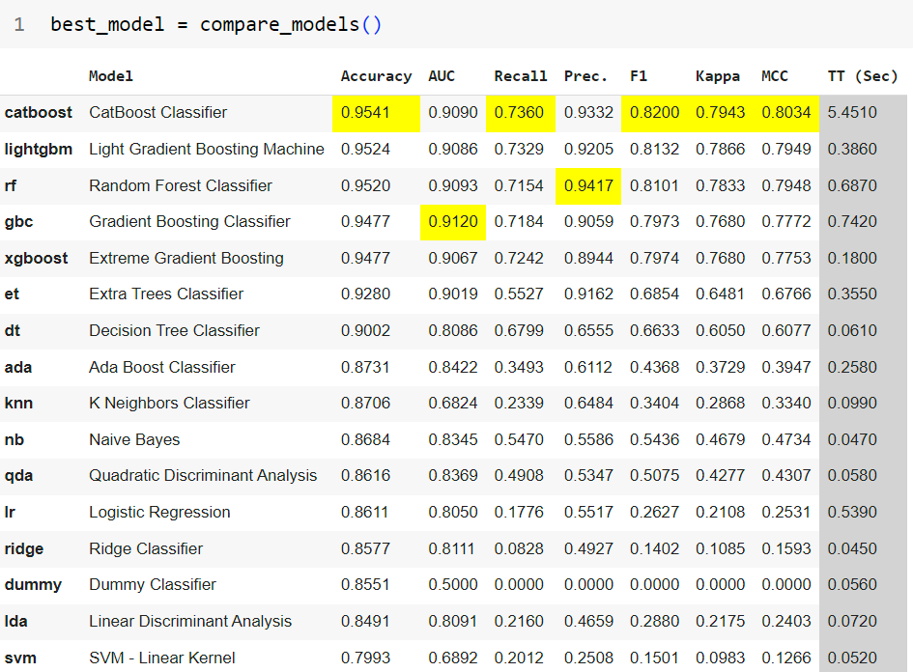
How do I know which model is the best for my classification problem?

Slide 83
Exercise 7
Get the best model for churn
Tune it for AUC
Plot the ROC curve
Plot the precision recall curve
Plot the confusion matrix
Plot feature importance

Slide 84
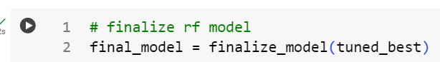
Finalize the Model for Deployment
The finalize_model function fits the model onto the complete dataset including the test/hold-out sample (30% in this case). The purpose of this function is to train the final model on the complete dataset before it is deployed in production.

Slide 85
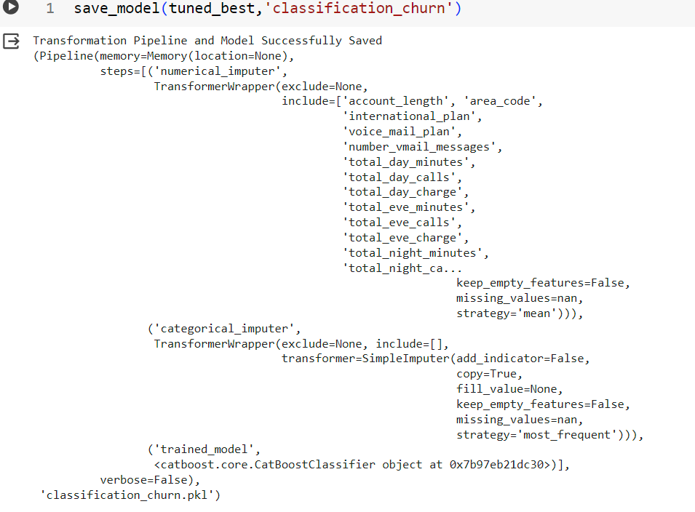
Save the model
PyCaret's inbuilt function save_model() allows you to save the model along with the entire transformation pipeline for later use

Slide 86
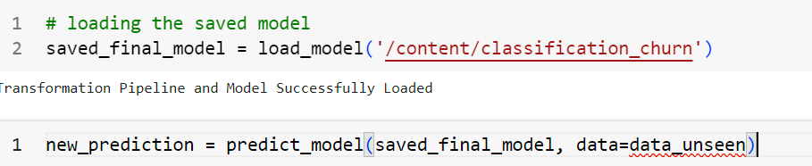
Load the saved model and make a prediction

Slide 87
Exercise 8
Get the best model for classifying diabetes
Tune the model for accuracy
Finalize the model
Save the model

Slide 88
Exercise 9
Create a model to predict genre based on music_clean.csv
Compare all the models
Plot relevant graphs
Finalize the best model
Save the model

Slide 89
Mentimeter
15-20-87-4

Slide 90
Exercise 10
Let's apply whatever we have learnt so far on the famous titanic dataset
And also create a streamlit app for the same
Deploy the streamlit app to cloud

Slide 91
Feedback
https://forms.gle/YxoACcestHVckNUz8

Slide 92
Thank You!

